Slide 1


Data Analytics
What Makes A Hit Movie
Qinya Li Yanghuizi Wang
Xiaohui Li Xiaoyu Xu Xiaoxuan Xia
1

Slide 2
Project Overview
Data Analysis
Model Construction
Conclusion
2

Slide 3

As movies have become important part of our daily lives, people go to see movies for various reasons. Some go for their favorite actors, some go because of other people’s good reviews, and some just go for fun. As a group, we think that there are a diversity of potential factors that can significantly contribute to a hit movie, so we made this research, based on some tools we’ve learned in the course.
Project Overview
3

Slide 4



Total: 2864
Genre
Release Date
2014 – 2018.06
Studio
Warner Bros
Walt Disney
20th Century Fox
Paramount Pictures
Universal
……
Critics
Review
99994 Reviews from 2664 films
Audience
Review
114601 Reviews from 1967 films
Genre
Adventure, Action,
Family, Fantasy,
Animation, Comedy,
Biography, Drama,
Musical, Crime,
Mystery, Thriller,
Sport, Horror, Sci-Fi,
History, Romance,
Music, Western
Release Date
Studio
Budget
Open Weekend Revenue
Gross Revenue
Actor
Director
Writer
Meta-Score
Reviews from Critics
Reviews from Audience
4

Slide 5

After gathering and filtering the data, we analyzed data to find some interesting patterns and provide useful insights. For example, which genres enjoy more praise and popular among audience. Whether movies’ revenues in open week and total box offices show different patterns among different genres or released date. On average, whether famous studios, outstanding movie actors or well-known directors gain higher ratings than normal ones.
Data Analysis
5

Slide 6
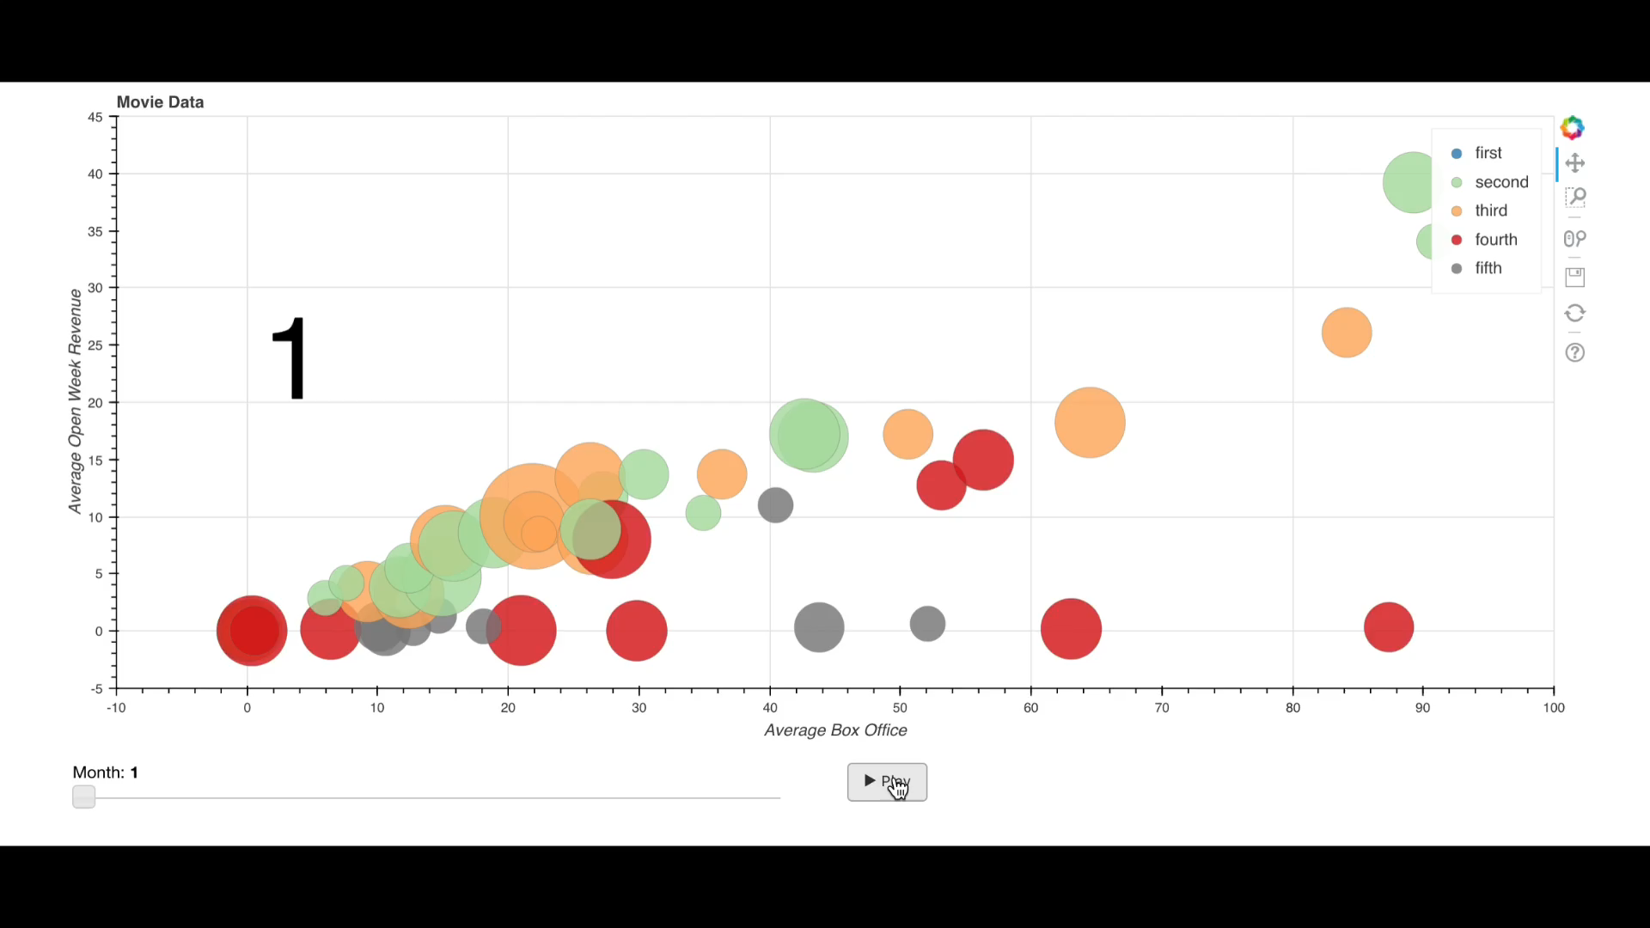
Comedy
01
02
17.13%
Other
12.37%
06

Thriller

→
39.76%
03



12.24%
Each month is illustrated in a graph, and the circle represents a group of movies with same ratings. The level of its rating is reflected by different colors, and the total amount of movies is reflected by its radius. Generally, higher revenues in open week and higher box offices in total usually hand in hand.
Crime
05
04
Action
8.00%
10.49%
Horror

Slide 7
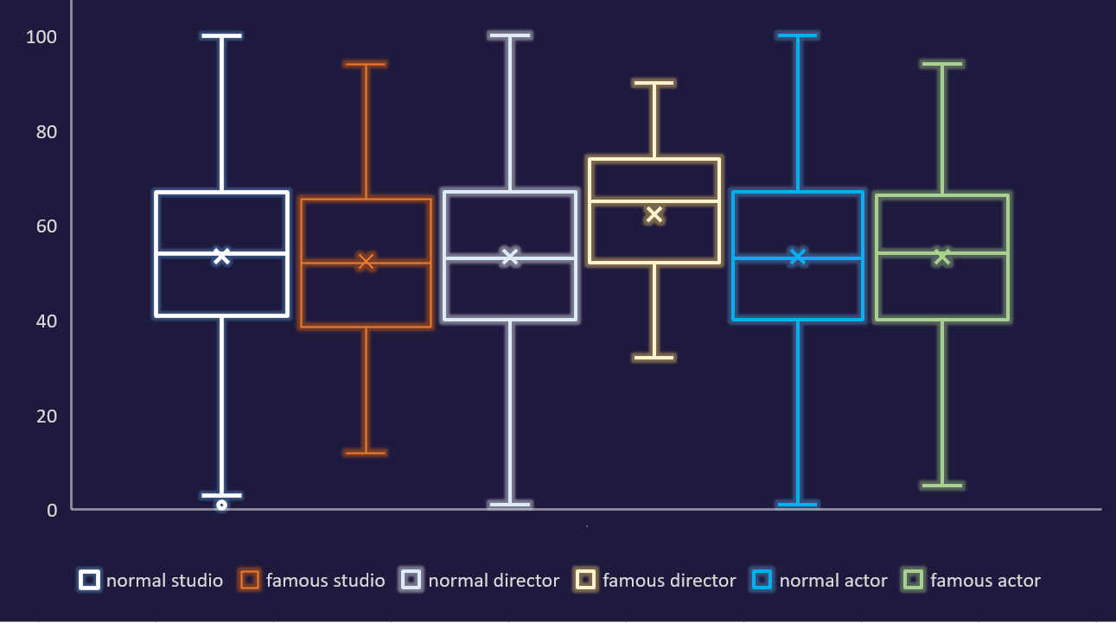
Studio
Director
Actor
7

Slide 8
Comedy
Action
8

Slide 9
Comedy
Adventure
Thriller
Action
Romance
9

Slide 10
Comedy
"Oscar bait" season
Adventure
Thriller
"blockbuster" release season
Action
"Dump months"
Romance
10

Slide 11
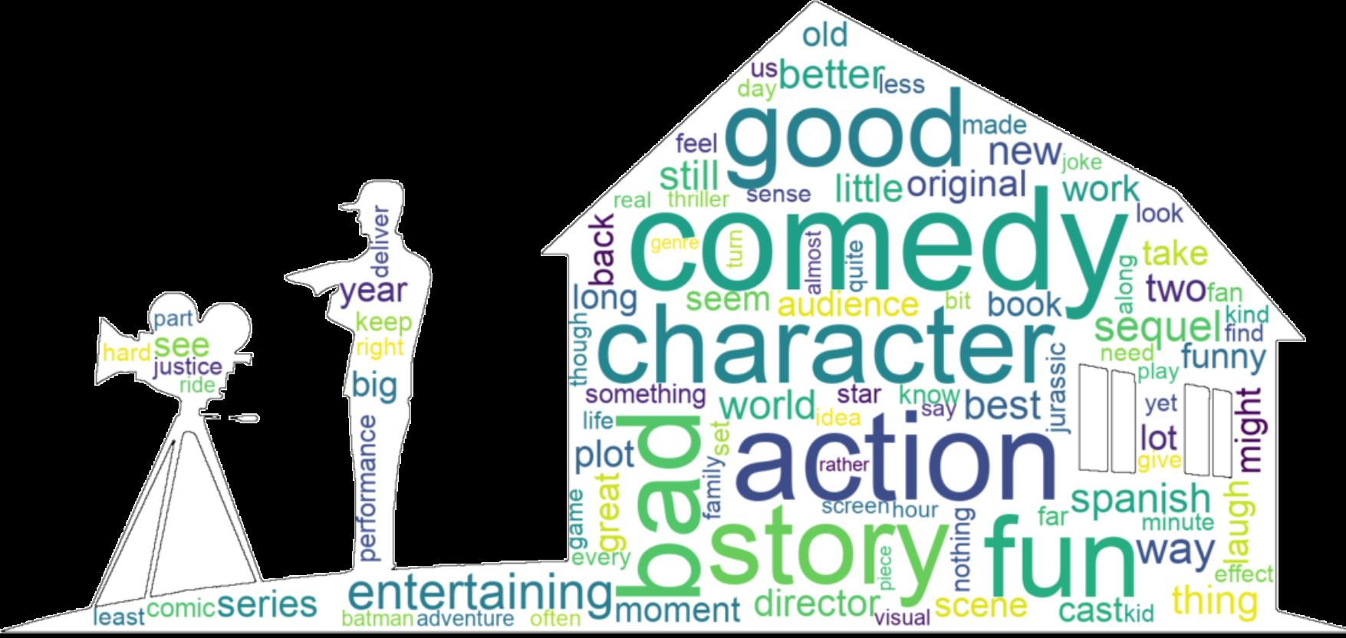

After analyzing the reviews from critics and audience of total different ratings, these distinct disagreements seem to be about certain types of movies, which are comedy, action and entertaining.
We conducted a comparison of the word clouds between comments from professional critics and general audiences.
11

Slide 12
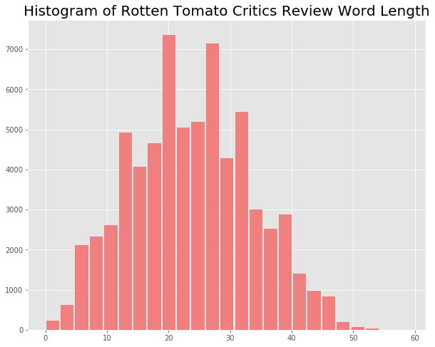
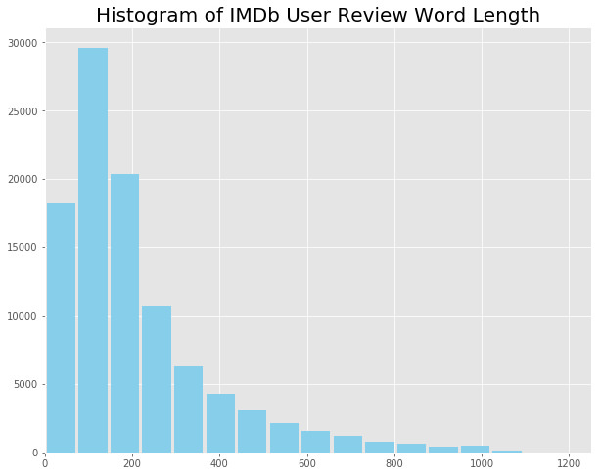
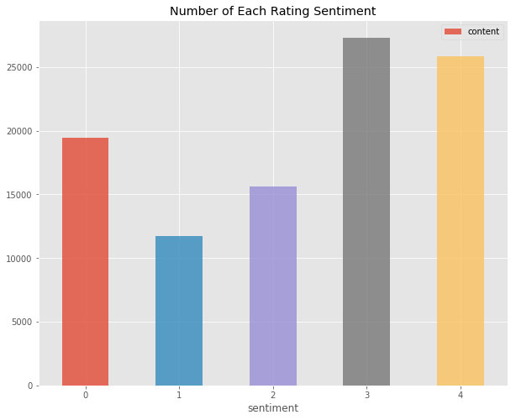
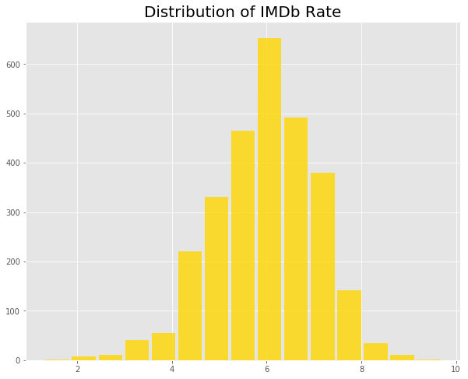
Rotten Tomato
Short Summary
IMDb
Large Paragraph
Very Positive
Positive
Neutral
Negative
Very Negative
12

Slide 13
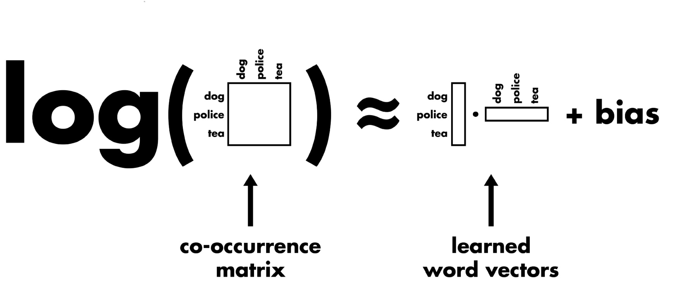
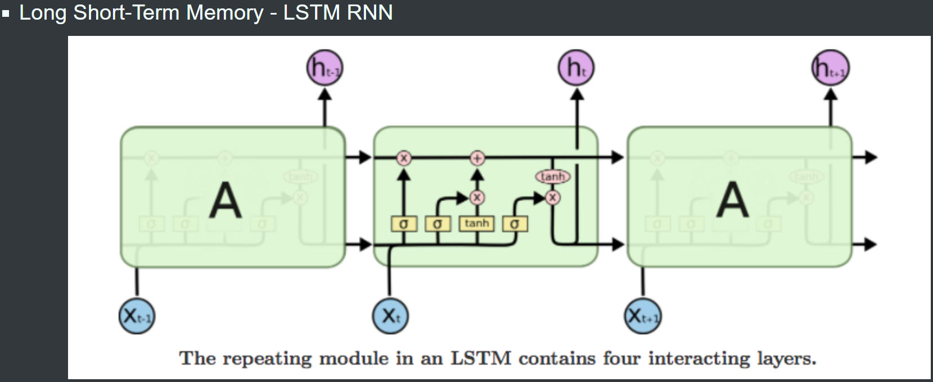
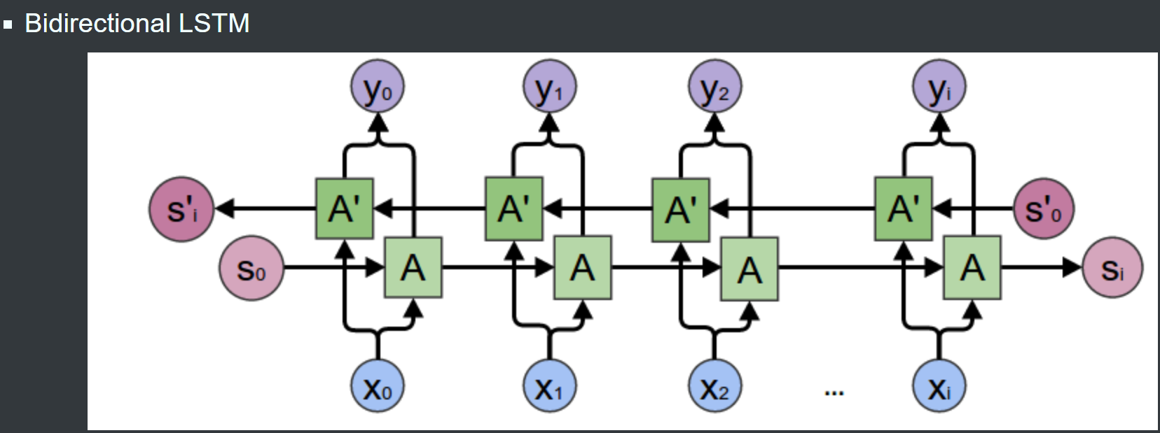
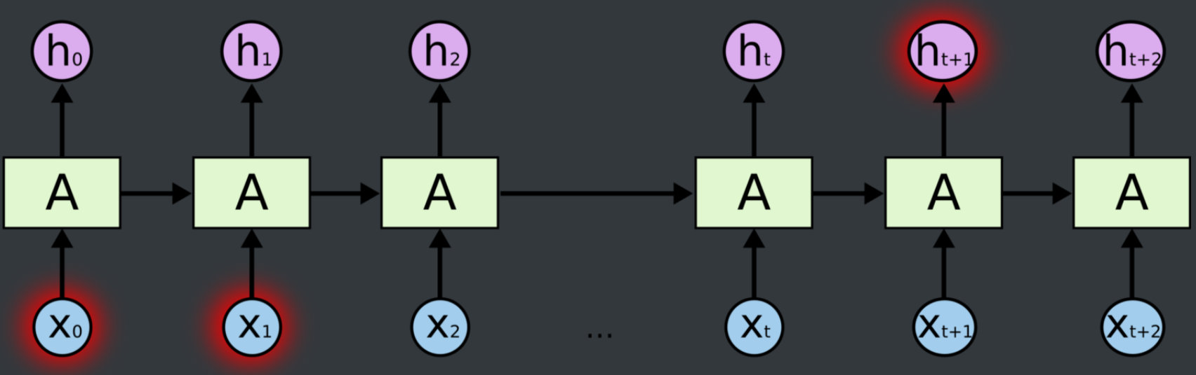
13

Slide 14
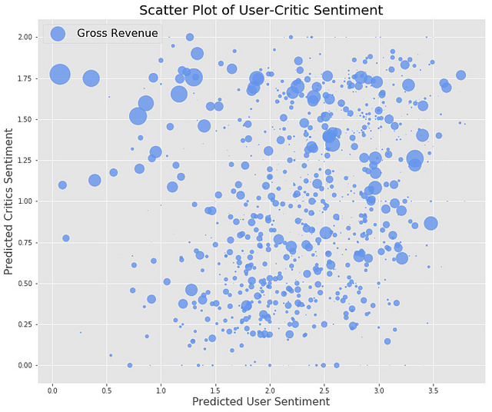
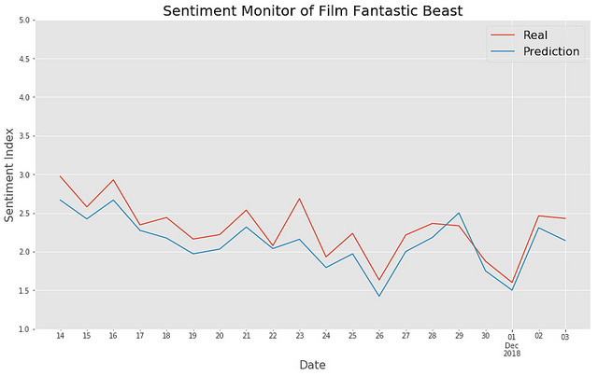
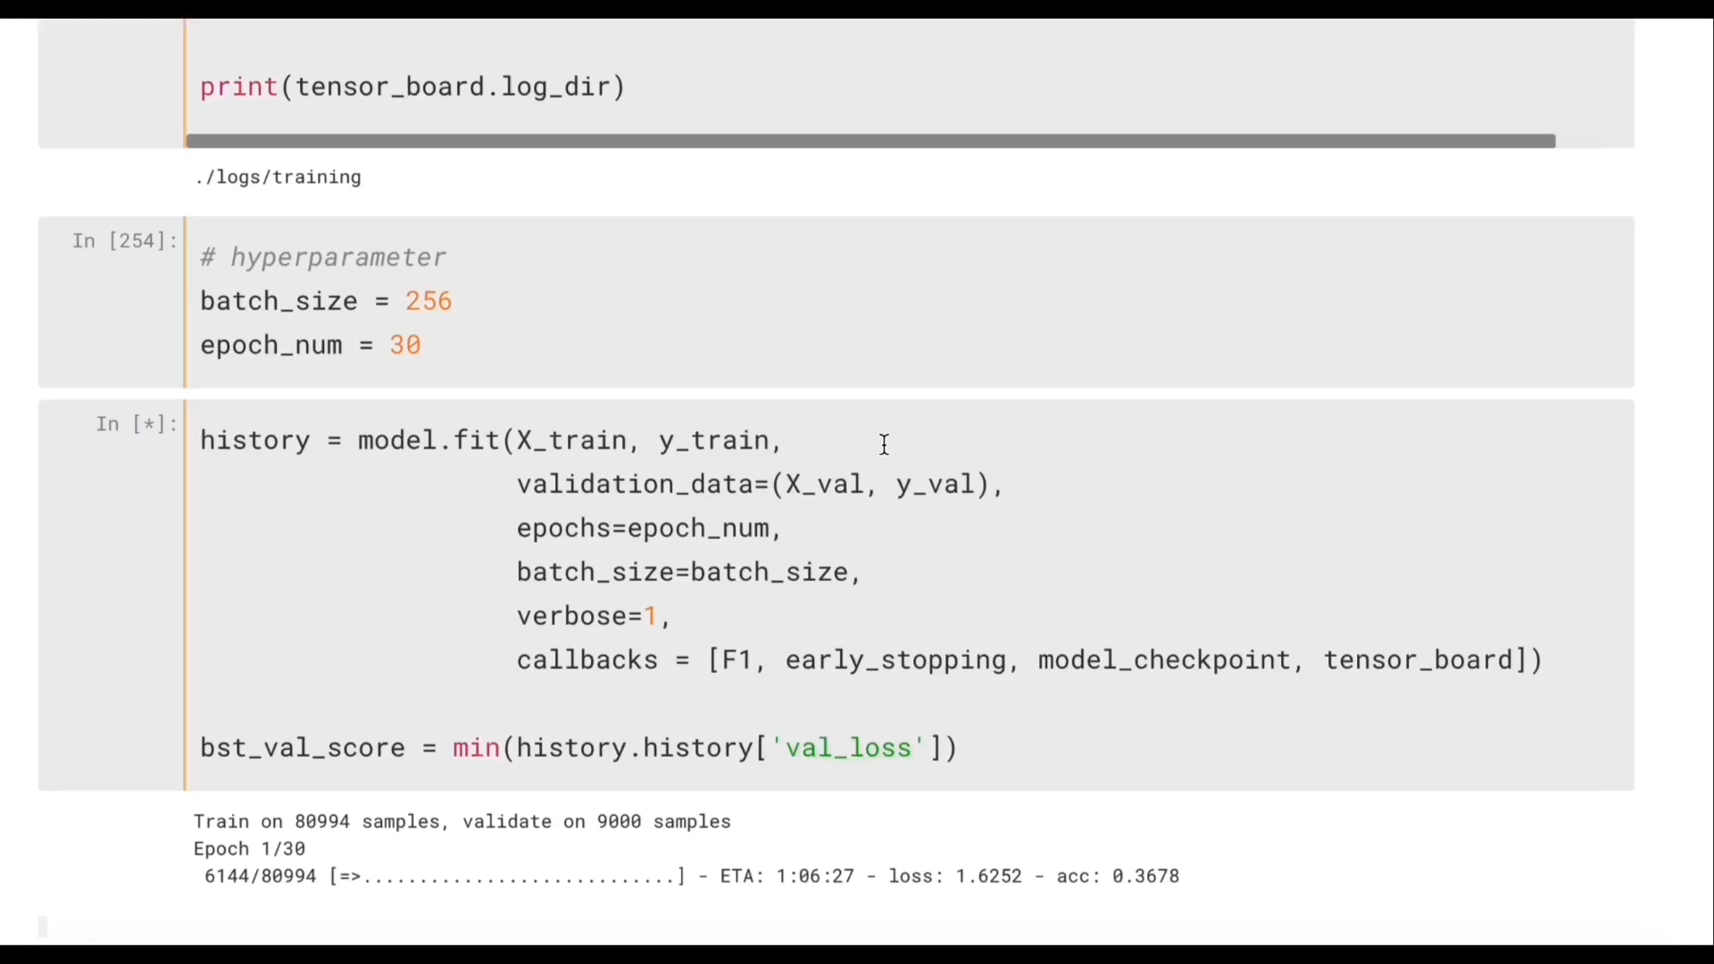
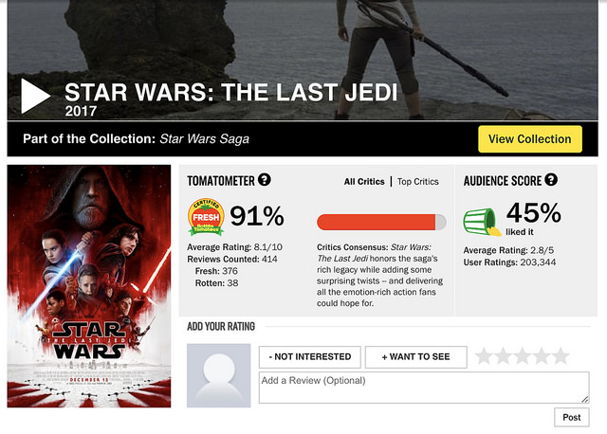
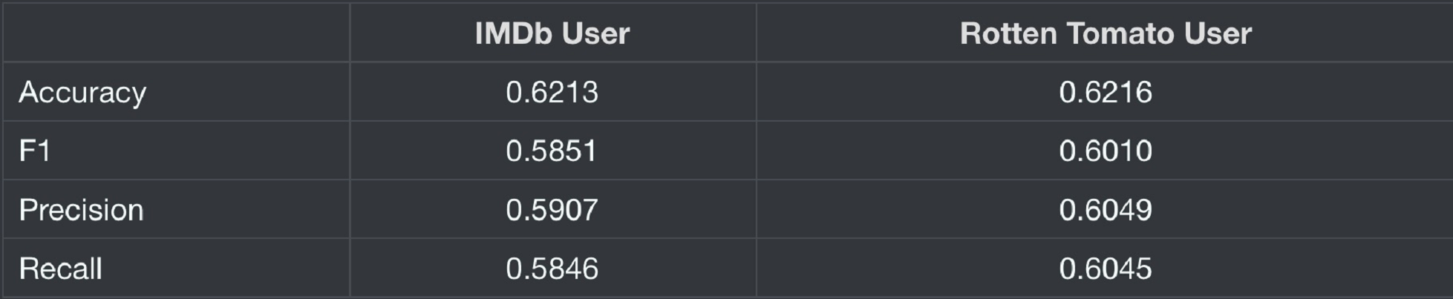
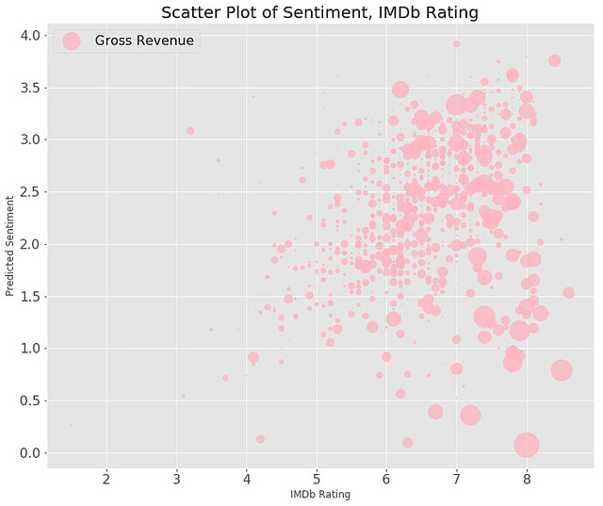
14

Slide 15
After cleaning data, analyzing data, it’s time for us to construct model to predict the Box Office.
We have built four models: Bayesian, Neural Network, SVM and XGBoost model. XGBoost stands out when we used four critical metrics to evaluate our models.
Model Construction
15

Slide 16
 | Bayesian | Neural Network | SVM | XGBoost
Precision | 67% | 57% | 84% | 77%
Recall | 64% | 46% | 43% | 76%
F-Score | 65% | 48% | 51% | 76%
Accuracy | 86% | 88% | 82% | 75%
Bayesian
Neural Network
SVM
XGBoost
16

Slide 17
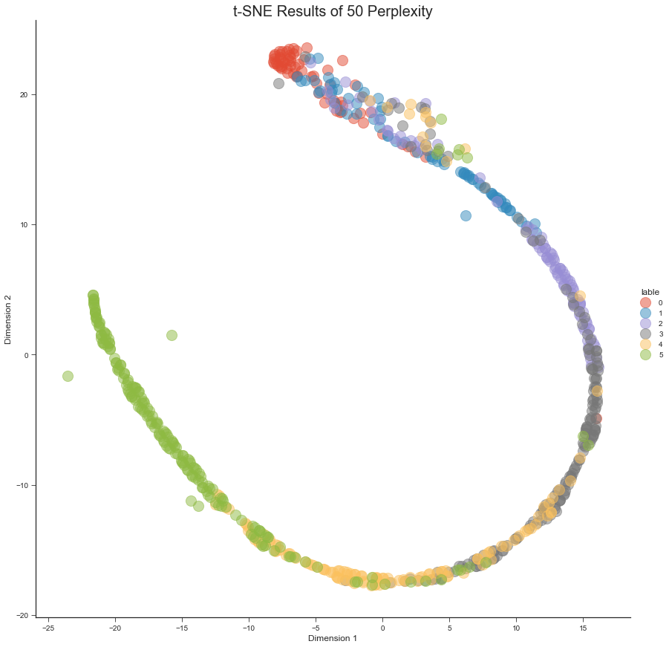
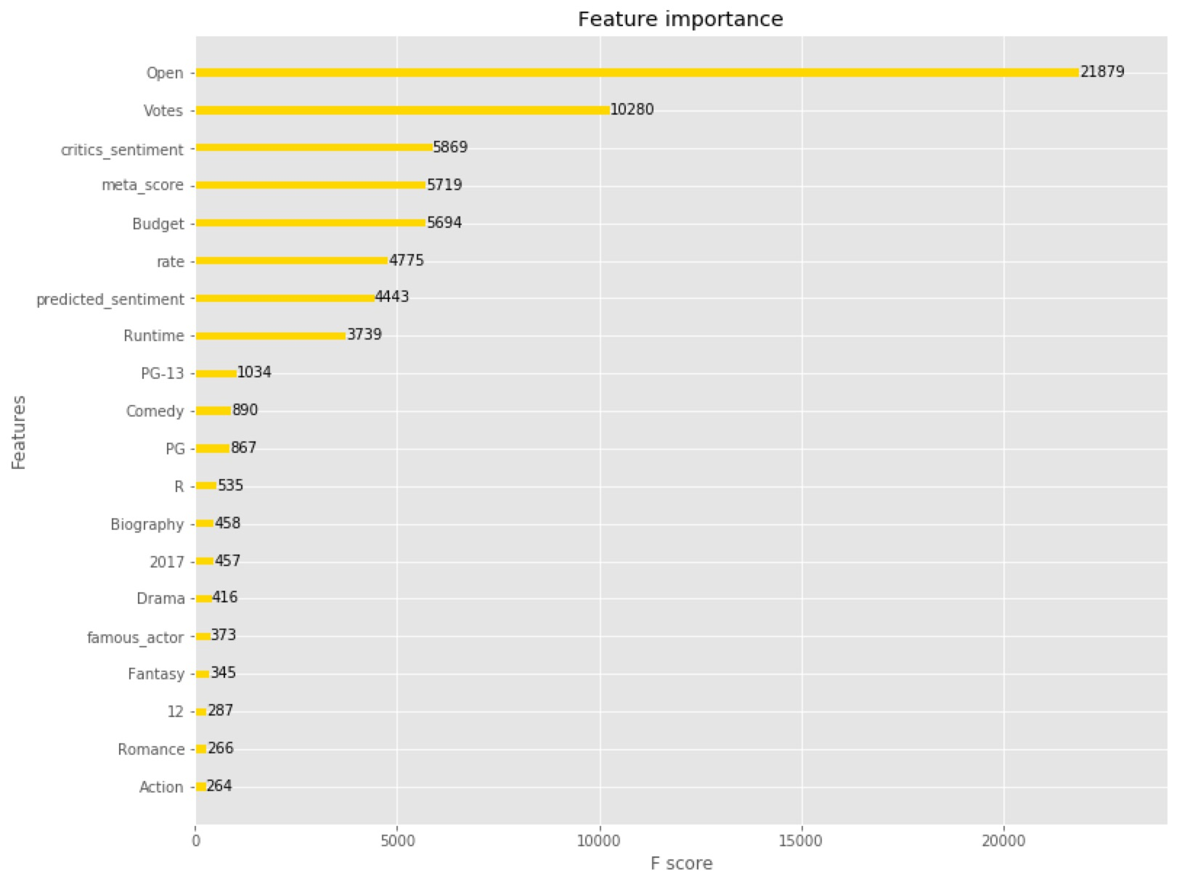
17

Slide 18

Big-deal sci-fiction movies flooding in during the summer vacation bring a feast for eyes to the audience, though not always acquiring corresponding praises. Instead, during October and November, the grand exhibition of Oscar-level hit movies are likely to make you a surprise.
What matters for a movie investor is the combo of famous director with all-star actors which contributes to a guarantee of considerable box office revenue. Nevertheless, open-week marketing is never less important as for promoting the earnings. At length, what equips a movie with the sustainability to survive the time is of course, its quality.
Conclusion
18

Slide 19

Data Analytics
THANKS FOR WATCHING

